Slide 1

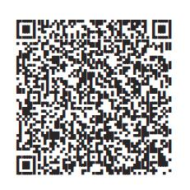

Choose what’s right
for you and your future.
Got a minute? That is all it takes to enroll in your <workplace savings plan>.
Text Enroll to 343-898
Scan QR code below
Visit NetBenefits.com/Easy
Client logo 1.2”’x1.25”
Questions about your plan? Go to NetBenefits.com or talk with a Fidelity representative at <XXX-XXX-XXXX>.
Scan here.
Enroll now.
Investing involves risk, including the risk of loss.
<The Plan is intended to be a participant-directed plan as described in Section 404(c) of ERISA, which means that fiduciaries of the Plan are ordinarily relieved of liability for any losses that are the direct and necessary result of investment instructions given by a participant or beneficiary.>
Message and data rates may apply. Get details at Digital.FidelityInvestments.com/smsee.
Fidelity Brokerage Services LLC, Member NYSE, SIPC, 900 Salem Street, Smithfield, RI 02917
© 2025 FMR LLC. All rights reserved. 1211529.1.1

